Slide 1
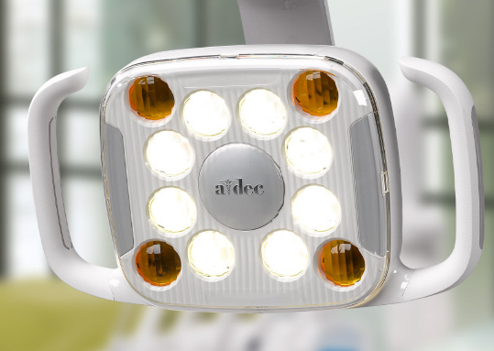
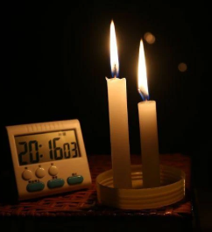
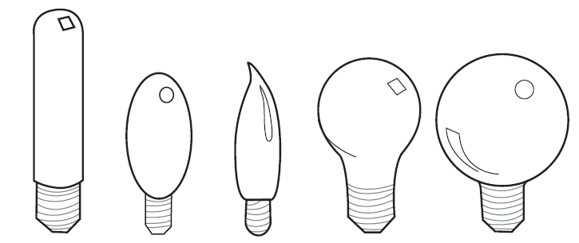
Illumination
Lighting or illumination is the deliberate use of light to achieve practical or aesthetic effects. Lighting includes the use of both artificial light sources like lamps and light fixtures, as well as natural illumination by capturing daylight. Proper lighting can enhance task performance, improve the appearance of an area, or have positive psychological effects on occupants.

Slide 2
Objective of this course
Give awareness to the ubiquitous presence of a little slice of the electromagnetic spectrum.
Impart what I have been able to remember of my scratching two sticks together to make fire and (magically) light.
Add to your appreciation for the wrangling of light to provide a benefit to our customers (The A-dec way).
Become an A-dec expert (although by guidance is only incidental).
Expand your mind.
Allow Chris to retire… although with some trepidation. My A-dec family is very dear to me!

Slide 3
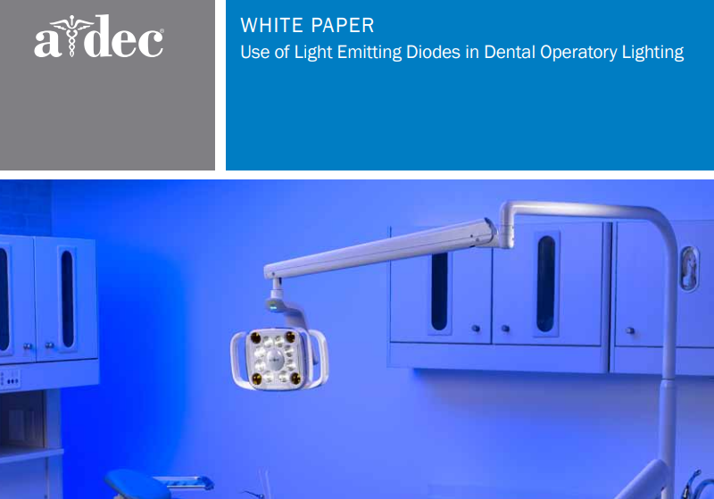

Slide 4
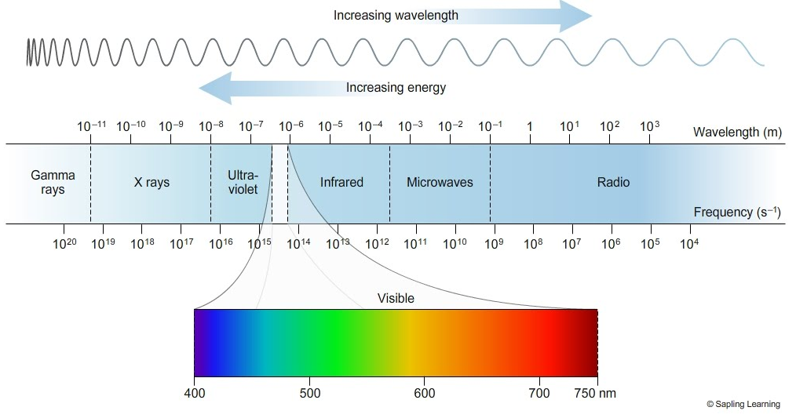
Electromagnetic Spectrum & the Visible Spectrum

Slide 5
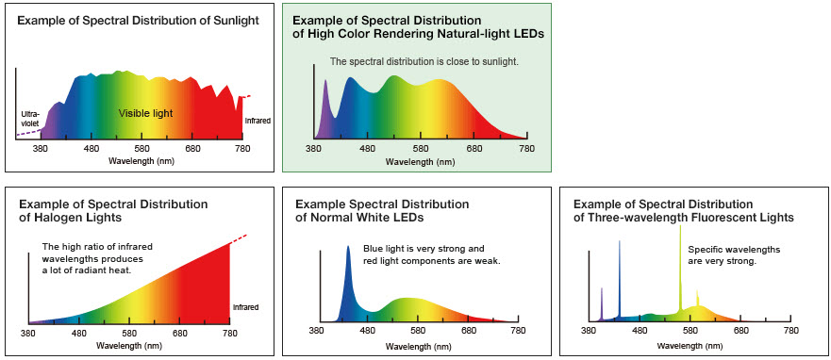
Spectral Power Distribution

Slide 6
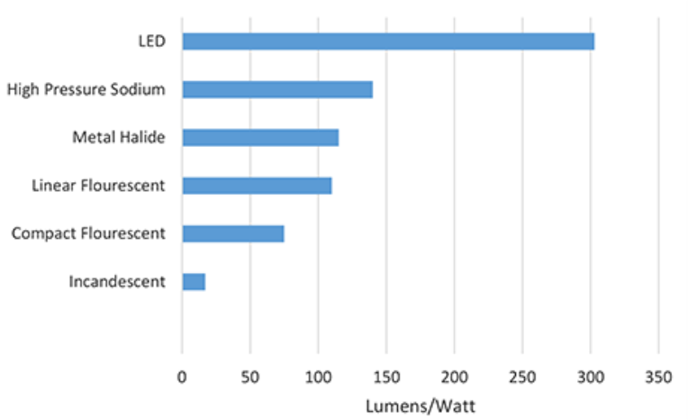
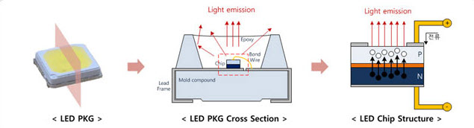
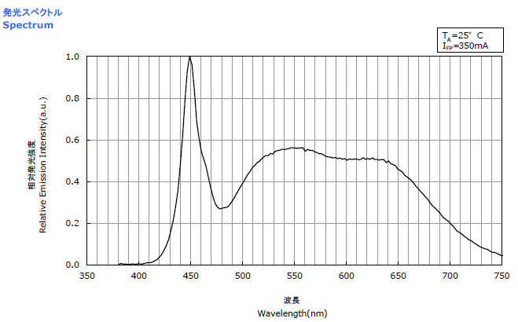
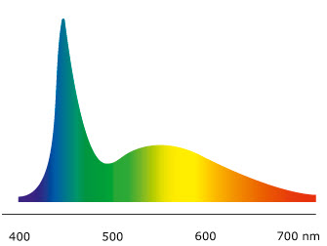
LEDs

Slide 7
How do we describe light?
Cold?
                Lumens? Chromaticity
Black Body CRI?
  Lux? Bright?
      UVA? Photopic?
    Candle power? Watt/m²
  Candela? SPD Joule?
        Watts? Scotopic?
                Candela-steridian? Hot?

Slide 8
Photometric versus radiometric quantities
There are two parallel systems of quantities known as photometric and radiometric quantities. Every quantity in one system has an analogous quantity in the other system.
Some examples of parallel quantities include: Luminance (photometric) and radiance (radiometric) Luminous flux (photometric) and radiant flux (radiometric) Luminous intensity (photometric) and radiant intensity (radiometric)

Slide 9
In photometric quantities every wavelength is weighted according to how sensitive the human eye is to it, while radiometric quantities use unweighted absolute power.
For example, the eye responds much more strongly to green light than to red, so a green source will have greater luminous flux than a red source with the same radiant flux would. Radiant energy outside the visible spectrum does not contribute to photometric quantities at all, so for example a 1000 watt space heater may put out a great deal of radiant flux (1000 watts, in fact), but as a light source it puts out very few lumens (because most of the energy is in the infrared, leaving only a dim red glow in the visible).

Slide 10
Radiometry -
is a set of techniques for measuring electromagnetic radiation, including visible light. Radiometric techniques in optics characterize the distribution of the radiation's power in space, as opposed to photometric techniques, which characterize the light's interaction with the human eye. Radiometry is distinct from quantum techniques such as photon counting.¹
1. Wikipedia https://en.wikipedia.org/wiki/Radiometry#Integral_and_spectral_radiometric_quantities

Slide 11

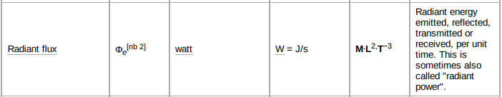
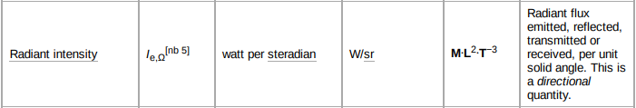
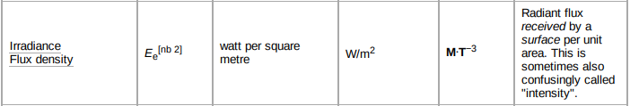

Slide 12
Photometry – What we perceive as light and color
Photometry is the science of the measurement of light, in terms of its perceived brightness to the human eye. It is distinct from radiometry, which is the science of measurement of radiant energy (including light) in terms of absolute power. In modern photometry, the radiant power at each wavelength is weighted by a luminosity function that models human brightness sensitivity. Typically, this weighting function is the photopic sensitivity function, although the scotopic function or other functions may also be applied in the same way²
2. Wikipedia https://en.wikipedia.org/wiki/Photometry_(optics)#:~:text=Photometry%20is%20the%20science%20of,in%20terms%20of%20absolute%20power.

Slide 13
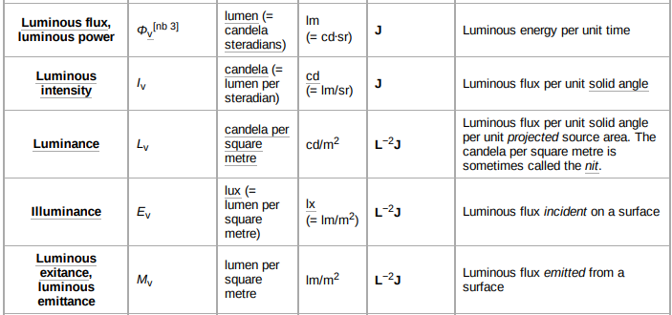
SI photometry units

Slide 14
Spreadsheet of Radiometric and corresponding Photometric units
https://team.a-dec.com/sites/deveng/Elect/Illumination/Shared%20Documents/PhotometricRadiometricUnits.xlsx
Radiometric and Photometric Quantities
SI Radiometry Units |  |  |  |  | SI Photometry Units
Quantity | Symbol | SI unit | Dimension | Notes | Quantity | Symbol | SI unit | Dimension | Notes
Radiant energy | Q_{e} | J | M⋅L²⋅T⁻² | energy | Luminous energy | Q_{v} | lm⋅s | T⋅J | units are sometimes called talbots
Radiant flux | Φ_{e} | W | M⋅L²⋅T⁻³ | radiant energy per unit time, also called radiant power | Luminous flux | Φ_{v} | lm | J | also called luminous power
Spectral power | Φ_{eλ} | W⋅m⁻¹ | M⋅L⋅T⁻³ | radiant power per wavelength
Radiant intensity | I_{e} | W⋅sr⁻¹ | M⋅L²⋅T⁻³ | power per unit solid angle | Luminous intensity | I_{v} | cd | J | an SI base unit
Spectral intensity | I_{eλ} | W⋅sr⁻¹⋅m⁻¹ | M⋅L⋅T⁻³ | radiant intensity per wavelength
Radiance | L_{e} | W⋅sr⁻¹⋅m⁻² | M⋅T⁻³ | power per unit solid angle per unit projected source area; confusingly called "intensity" in some other fields of study | Luminance | L_{v} | cd/m² | L⁻²⋅J | units are sometimes called nits

Slide 15
Non-SI photometry units
Luminance
  Footlambert
  Millilambert
  Stilb
Illuminance
  Foot-candle
  Phot
Minutiae (no it’s not a unit)
Candlepower (abbreviated as cp or CP) is an obsolete unit of measurement for luminous intensity. It expresses levels of light intensity relative to the light emitted by a candle of specific size and constituents. The historical candlepower is equal to 0.981 candelas. In modern usage, candlepower is sometimes used as a synonym for candela.^{[1]}

Slide 16
Of historical interest? https://en.wikipedia.org/wiki/Candlepower
The term candlepower was originally defined in the United Kingdom, by the Metropolitan Gas Act 1860, as the light produced by a pure spermaceti candle that weighs ¹⁄₆ pound (76 grams) and burns at a rate of 120 grains per hour (7.8 grams per hour). Spermaceti is a material from the heads of sperm whales, and was once used to make high-quality candles.
At the time the UK established candlepower as a unit, the French standard of light was based on the illumination from a Carcel burner. They defined the unit was that illumination that emanates from a lamp burning pure colza oil (obtained from the seed of the plant Brassica campestris) at a defined rate. Ten standard candles equaled about one Carcel burner.
In 1909, several agencies met to establish an international standard. It was attended by representatives of the Laboratoire Central de l’Electricité (France), the National Physical Laboratory (UK), the Bureau of Standards (United States), and the Physikalische Technische Reichsanstalt (Germany). The majority redefined the candle in term of an electric lamp with a carbon filament. The Germans, however, dissented and decided to use a definition equal to 9/10 of the output of a Hefner lamp.
In 1921, the Commission Internationale de l'Eclairage (International Commission for Illumination, commonly referred to as the CIE) redefined the international candle again in terms of a carbon filament incandescent lamp.
In 1937, the international candle was redefined again—against the luminous intensity of a blackbody at the freezing point of liquid platinum which was to be 58.9 international candles per square centimetre.
In 1948, the international unit (SI) candela replaced candlepower. One candlepower unit is about 0.981 candela. In general modern use, a candlepower now equates directly (1:1) to the number of candelas^{[1]}—an implicit increase from its old value.

Slide 17
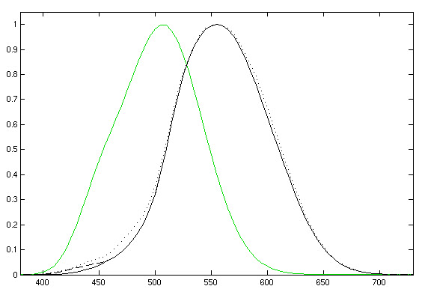
Scotopic vision is the vision of the eye under low-light levels. The term comes from Greek skotos, meaning "darkness", and -opia, meaning "a condition of sight".^{[1]} In the human eye, cone cells are nonfunctional in low visible light. Scotopic vision is produced exclusively through rod cells, which are most sensitive to wavelengths of around 498 nm (green–blue) and are insensitive to wavelengths longer than about 640 nm (reddish orange). This condition is called the Purkinje effect.
https://en.wikipedia.org/wiki/Scotopic_vision
https://en.wikipedia.org/wiki/Photopic_vision
Photopic vision is the vision of the eye under well-lit conditions (luminance level 10 to 10⁸ cd/m²). In humans and many other animals, photopic vision allows color perception, mediated by cone cells, and a significantly higher visual acuity and temporal resolution than available with scotopic vision.

Slide 18
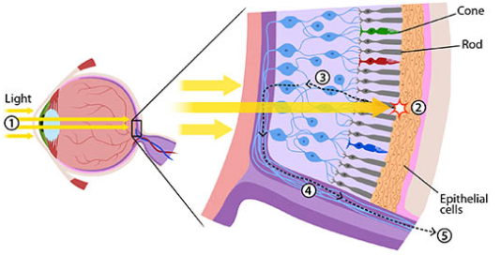
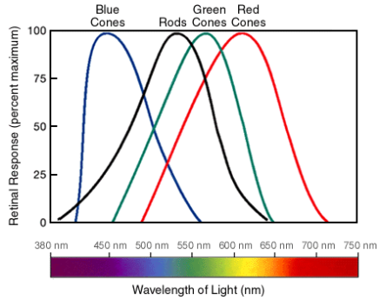
The human eye uses three types of cones to sense light in three bands of color. The biological pigments of the cones have maximum absorption values at wavelengths of about 420 nm (blue), 534 nm (bluish-green), and 564 nm (yellowish-green). Their sensitivity ranges overlap to provide vision throughout the visible spectrum. The maximum efficacy is 683 lm/W at a wavelength of 555 nm (green).^{[1]} By definition, light at a frequency of 5.4×10¹⁴ hertz (λ = 555.17. . . nm) has a luminous efficacy of 683 lm/W.
https://askabiologist.asu.edu/rods-and-cones

Slide 19
Did you know?
The wavelengths for when a person is in photopic vary with the intensity of light. For the blue-green region (500 nm), 50% of the light reaches the image point of the retina.

Slide 20
Adaptation
Adaptation is much faster under photopic vision; it can occur in 5 minutes for photopic vision but it can take 30 minutes to transition from photopic to scotopic.^{[2]}
Most older adults lose photopic spatial contrast sensitivity. Adults in their 70s require about three times more contrast to detect high spatial frequencies than adults in their 20s.^{[3]}
The human eye uses scotopic vision under low-light conditions (luminance level 10⁻⁶ to 10^{−3.5} cd/m²), and mesopic vision in intermediate conditions (luminance level 10⁻³ to 10^{0.5} cd/m²).

